Slide 1
Bridging the Digital Divide
Understanding Challenges and Strategies

Slide 2
Table of Contents
Affordability Issues
03
Infrastructure Challenges
04
Introduction to the Digital Divide
05
Gender Inequality in Digital Access
06
Conclusion
07
Policy Pitfalls and Recommendations
08

Slide 3

Affordability Issues
Cost barrier for low-income households
High device costs limit internet access for many.

Slide 4
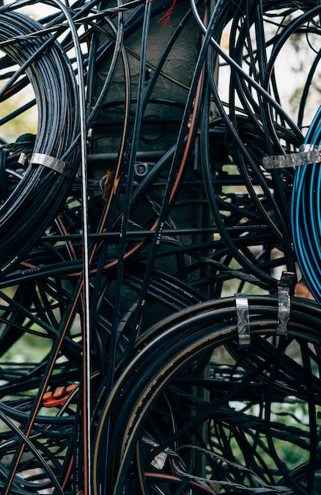
Infrastructure Challenges
Rural vs urban access
Challenges in reaching remote areas
Disparities in internet availability
Investment in broadband
Funding for high-speed internet infrastructure
Support for expanding broadband networks

Slide 5

Introduction to the Digital Divide
Definition and scope
Understanding digital disparity globally
Scope of digital exclusion challenges
Global impact
Societal and economic implications worldwide
Global repercussions of digital inequality

Slide 6

Gender Inequality in Digital Access
Statistics on gender disparity
Women face limited access due to cultural norms.
Cultural and social barriers
Trust issues hinder women's engagement with online world.

Slide 7

Conclusion
Summary of key points
Complex barriers: infrastructure, affordability, literacy, gender gap
Policy challenges: restrictive regulations, telecom sector limitations
Collaborative solutions: public-private partnerships, targeted programs
Call to action for stakeholders
Support inclusive policies
Invest in digital literacy programs
Promote gender equality initiatives
Photo by Efe Kurnaz

Slide 8

Policy Pitfalls and Recommendations
Identifying key policy gaps
Restrictive government policies
Limited competition in telecom sector
Lack of clear frameworks for universal access
Strategies for inclusive digital policies
Promote open and competitive market
Support universal access frameworks
Encourage public-private partnerships

